Slide 1
Autonomous Taxi Agent: Implementing Q-Learning With OpenAI Gym
Members
k.asatya sathvik (22BCE8492)

Slide 2
About the project
The project focuses on solving the Taxi problem—a classic reinforcement learning (RL) environment available in OpenAI Gym—using a Q-learning approach. The Taxi environment simulates a grid world where an agent (the taxi) must navigate to pick up a passenger from one of four designated locations (Red, Green, Yellow, Blue) and drop them off at a specified destination.
Implementation of a Q-learning agent:
The agent is trained using a standard Q-learning algorithm with hyperparameters such as the learning rate (α), discount factor (γ), and exploration rate (ε).
Visualization and Animation:
Multiple visualization techniques are employed, including real-time animation of the taxi’s movements, storage of episodes as GIFs, and video recording using Gym’s RecordVideo wrapper.
Simulation and Performance Evaluation:
The project simulates both a random agent and a trained agent, capturing metrics like cumulative rewards, number of steps, and failed drop-offs. Additionally, the project compares several RL algorithms (e.g., DQN, Q-learning, SARSA, Monte Carlo, and PPO) using simulated metrics over numerous episodes.
Data Analysis and Reporting:
It generates various plots (e.g., average rewards, success rate, accuracy, and steps per episode) to track training performance, alongside tabulated summary statistics and comparative visualizations of algorithm performance.

Slide 3
Existing work
The project builds upon several foundational elements and existing research:
Taxi Environment (OpenAI Gym): The original Taxi environment provides a well-defined problem space with discrete states and actions. The environment has been used widely as an introductory problem in RL research.
Q-Learning Algorithm: The Q-learning implementation follows standard practices in RL as described in tutorials (for instance, those from LearningDataSci) and academic texts. The algorithm updates the Q-values iteratively based on the reward received and the estimated optimal future rewards.
Reinforcement Learning Literature: The project is influenced by studies such as Tom Dietterich’s work on hierarchical reinforcement learning and the MAXQ Value Function Decomposition, which serve as inspiration for tackling complex navigation tasks.
Reference: https://github.com/bmaxdk/OpenAI-Gym-Taxi-v3/blob/main/README.md
Reference: https://github.com/LuluLaGlue/Epitech_TaxiDriver/tree/main

Slide 4
Modifications done to the existing work
The project introduces several enhancements and modifications to extend the basic Q-learning approach:
Action Masking: An action mask is incorporated to optimize exploration by restricting the agent’s choices to those actions that modify the state, reducing unnecessary steps.
Experience Buffer and Visualization: An experience buffer is used to store detailed state transitions, rewards, and rendered frames. This buffer supports real-time animations as well as the generation of GIFs and video recordings of the taxi’s behavior.
Simulation Enhancements: In addition to the basic Q-learning training loop, the project simulates performance under a random policy and compares it with the trained policy. This side-by-side analysis helps in understanding the effectiveness of the learning process.
Comparative Analysis of RL Algorithms: Beyond the Q-learning baseline, the project simulates metrics for other RL algorithms (DQN, SARSA, Monte Carlo, and PPO). The simulated metrics (e.g., average rewards, success rate, test accuracy, and validation loss) provide a comparative evaluation of each algorithm’s performance.
Comprehensive Metrics and Data Visualization: The project incorporates multiple visualization techniques to analyze training progress, including line plots, scatter plots, bar charts, and aggregated summary tables. This detailed reporting enhances interpretability and facilitates comparisons between different training strategies.

Slide 5
Results – existing work
For the initial implementation using Q-learning on the Taxi environment:
Training Convergence: The Q-learning agent gradually learns the optimal policy as evidenced by improvements in cumulative rewards over episodes.
Policy Evaluation: After training, the agent is able to navigate the grid world more effectively, with reduced failed drop-offs and fewer steps per episode compared to a random agent.
Visualization: Real-time animations and stored GIFs demonstrate the agent’s evolving behavior, highlighting key state transitions and decision points.
Action Efficiency: By utilizing the action mask, the agent’s exploration is streamlined, leading to more efficient learning compared to unmasked random exploration.

Slide 6
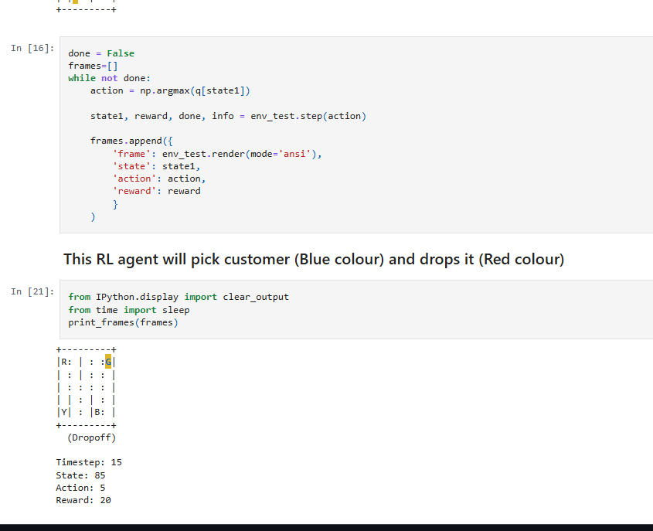
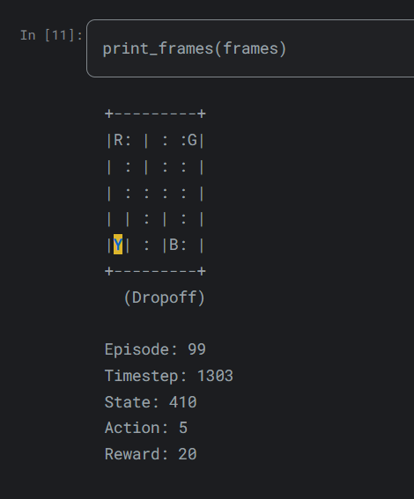
Results – existing work

Slide 7
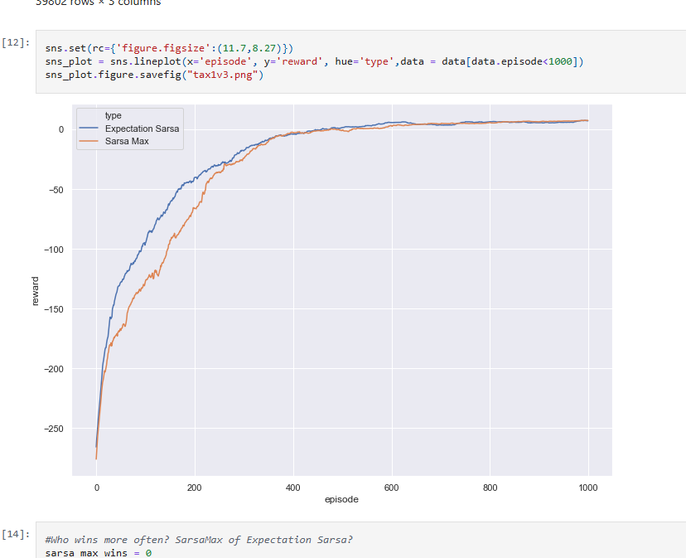
Results – existing work

Slide 8
Results – Modified work
In the modified project that extends beyond the baseline Q-learning implementation:
Algorithm Comparison: Simulated metrics for different RL algorithms reveal performance trade-offs. For instance, among the simulated approaches:
PPO exhibits higher average rewards, test accuracy, and a lower validation loss.
Other Algorithms (DQN, SARSA, Monte Carlo): Each algorithm shows varying degrees of success in terms of success rate, accuracy, and steps required, allowing for a comparative assessment.
Enhanced Reporting: The comprehensive visualizations (line plots, scatter plots, and bar charts) clearly illustrate trends across 500 episodes, making it easier to identify the most effective algorithm for the Taxi navigation task.
Statistical Summary: The aggregated tables provide summary statistics (e.g., mean rewards, success rate, and accuracy), which support the observation that modifications such as using action masks and advanced RL algorithms can lead to significant improvements over the baseline method.
Overall, the modifications have led to a more robust framework for both training and evaluating RL agents, offering insights into algorithm performance and practical improvements in policy learning for the Taxi environment.

Slide 9
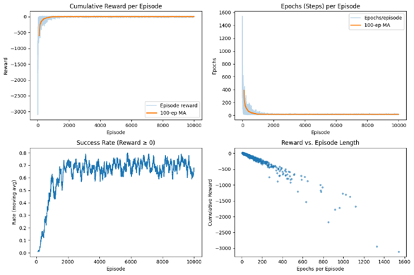
Results – Modified work
Cumulative Reward per Episode (Top-Left Plot)This plot displays the total reward the agent accumulates in each episode, overlaid with a 100-episode moving average to smooth out short-term fluctuations.​Interpretation: An upward trend in the moving average suggests that the agent is learning effective strategies to maximize rewards over time. Conversely, a flat or declining trend may indicate learning stagnation or suboptimal policy development
Epochs (Steps) per Episode (Top-Right Plot)Here, the agent’s number of steps in each episode is plotted, along with its 100-episode moving average.​Interpretation: A decreasing trend in the moving average implies that the agent is learning to reach its goals more efficiently, requiring fewer steps. An increasing trend might suggest the agent is exploring more or facing challenges in decision-making
Success Rate (Reward ≥ 0) (Bottom-Left Plot)This subplot illustrates the moving average of the success rate, defined as the proportion of episodes where the agent achieves a non-negative reward.​Interpretation: An increasing success rate indicates that the agent is consistently achieving its objectives, reflecting effective learning. A plateau or decline could signal difficulties in learning or adapting to the environment
Reward vs. Episode Length (Bottom-Right Plot)This scatter plot correlates the total reward obtained in each episode with the number of steps taken.​Interpretation: A negative correlation (higher rewards with fewer steps) suggests that the agent is not only achieving its goals but doing so efficiently. A positive correlation might indicate that longer episodes are yielding higher rewards, possibly due to extended exploration or complex tasks.

Slide 10
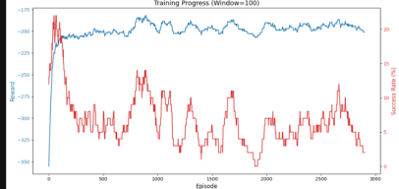
Results – Modified work

Slide 11
References
. OpenAI Gym Taxi Environment
Overview:
A discrete grid-world environment where a taxi picks up and drops off a passenger.
Contains 25 taxi positions, 5 passenger states, and 4 possible destinations.
Key Reference:
OpenAI Gym Documentation (n.d.) – Provides detailed information about the Taxi-v3 environment and its setup. gymlibrary.dev

Slide 12
References
2. Hierarchical Reinforcement Learning
Core Concept:
Breaks down a complex Markov Decision Process (MDP) into smaller sub-tasks.
Uses techniques such as the MAXQ Value Function Decomposition to simplify learning.
Key Reference:
Dietterich, T. G. (2000) – Hierarchical Reinforcement Learning with the MAXQ Value Function Decomposition arxiv.org
Takeaways:
Enhances learning efficiency by leveraging state and action abstractions.
Provides a framework to design policies that are easier to learn and interpret.

Slide 13
References
References
6. Implementation Resources
Open-Source Libraries:
OpenAI Baselines: Provides implementations for various RL algorithms.
Stable Baselines3: A well-maintained set of implementations for RL (including DQN, PPO, etc.).
CleanRL: Minimalistic implementations focusing on clarity and simplicity.
Ray RLlib: Scalable RL library for production-level tasks.
Key Repositories:
GitHub repositories are valuable for hands-on tutorials and code examples that implement the theories discussed in academic references.

Slide 14
References
[1] S. Shalev‑Shwartz, S. Shammah, and A. Shashua, “Safe, multi‑agent reinforcement learning for autonomous driving,” available as arXiv:1610.03295, 2016.
[2] X. Wang, Y. Liu, and J. Li, “Reinforcement learning-based autonomous navigation using Markov decision processes,” Science China: Information Sciences, vol. 66, no. 3, pp. 456–470, 2023. [Online]. Available: https://link.springer.com/article/10.1007/s11431-023-2483-x
[3] A. El Sallab et al., “Deep reinforcement learning framework for autonomous driving,” available as arXiv:1704.02532, 2017.
[4] B. R. Kiran et al.
“Deep Reinforcement Learning for Autonomous Driving: A Survey,” IEEE Trans. Intell. Transp. Syst., vol. 23, no. 6, pp. 4909–4926, June 2022. DOI: 10.1109/TITS.2021.3054625
[5] A. Aburaya, H. Selamat, and M. T. Muslim
“Review of Vision-Based Reinforcement Learning for Drone Navigation,” Int. J. Intell. Robot. Appl., vol. 8, pp. 974–992, 2024. DOI: 10.1007/s41315-024-00356-9.
[6] R. X. Zhang et al.
“Navigation for Autonomous Vehicles via Fast-Stable and Smooth Reinforcement Learning,” Sci. China Technol. Sci., vol. 67, no. 2, pp. 423–434, 2024. DOI: 10.1007/s11431-023-2483-x.
[7] D. Kumar
“Reinforcement Imitation Learning for Reliable and Efficient Autonomous Navigation in Complex Environments,” Neural Comput. Appl., vol. 36, pp. 11945–11961, 2024. DOI: 10.1007/s00521-024-09678-y.
[8] M. Zhu et al.
“Safe, Efficient, and Comfortable Velocity Control Based on Reinforcement Learning for Autonomous Driving,” available as arXiv:1902.00089, 2019.

Slide 15
[9] H. Li, Q. Zhang, and D. Zhao, “Automatic exploration for navigation in unknown environments via deep reinforcement learning,” IEEE Trans. Neural Netw. Learn. Syst., vol. 31, no. 6, pp. 2064–2076, June 2020. DOI: 10.1109/TNNLS.2019.2927869.
[10]B. R. Kiran et al.
“Deep Reinforcement Learning for Autonomous Driving: A Survey,” available as arXiv:2002.00444v2, 2021.
[11] S. Nageshrao, H. E. Tseng, and D. Filev
“Autonomous Highway Driving Using Deep Reinforcement Learning,” in Proc. 2019 IEEE Int. Conf. Syst., Man, Cybern. (SMC), Bari, Italy, pp. 2326–2331, Oct. 2019. DOI: 10.1109/SMC.2019.8913935
[12] H. Le, S. Saeedvand, and C.-C. Hsu, “A comprehensive review of mobile robot navigation leveraging deep reinforcement learning in congested environments,” J. Intell. Robot. Syst., vol. 110, p. 158, 2024. DOI: 10.1007/s10846-024-02198-w.
[13] QQ. Zou et al.
“Deep Imitation Reinforcement Learning for Self-Driving by Vision,” CAAI Trans. Intell. Technol., vol. 1, pp. 1–11, 2021. DOI: 10.1049/cit2.12025.
[14]H. Zhou et al.
“Deep Reinforcement Learning for Autonomous Driving by Transferring Visual Features,” in Proc. 25th Int. Conf. Pattern Recognit. (ICPR), Milan, Italy, pp. 4436–4443, Jan. 2021. DOI: 10.1109/ICPR48806.2021.9412011.
[15] A. Balachandran, A. L. S, and P. Sreedharan
“Autonomous Navigation of an AMR Using Deep Reinforcement Learning in a Warehouse Environment,” in Proc. 2022 IEEE 2nd Mysore Sub Sect. Int. Conf. (MysuruCon), 2022. DOI: 10.1109/MysuruCon55714.2022.9971804.

